Slide 1
Emotion Recognition Through Audio Analysis
YWCC307
Meciel Guisihan

Slide 2
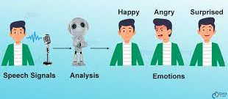
Introduction
Speech Emotional Recognition (SER)
Recognizing emotional/nonverbal aspects of speech to analyze vocal behavior
Ongoing Research
Programmable devices still lack this ability, but more research is being conducted to find a solution for this

Slide 3
Research
Goal: Making machines recognize human emotions for them to act in a more “human-like manner”
Mobile phone users, call center operators, car drivers, pilots, and human to machine interactions
Why?
Have more convincing conversations between machine and human by appealing to human emotion
Human-machine trust and understanding
Humans can be replaced by machines in some of these aspects

Slide 4
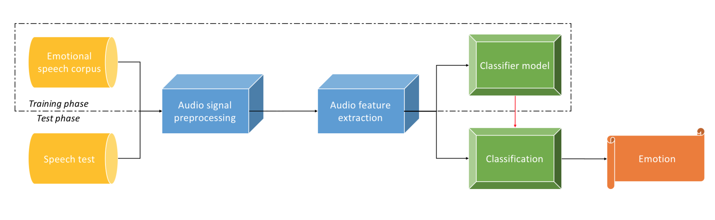
How?
Machine Learning
Calculates feature parameters from raw data (videos, pictures, etc.)
Features also used to train model to produce desired output labels
3 Steps:
Signal processing
Splitting signals into units
Feature extraction
Classification

Slide 5
Problem/Solution
Problem: Unsure which features are the best at clustering data
Solution: Optimal feature selection through deep neural networks (DNN) classifiers
Use an end-to-end network that takes raw data as an input and creates a class label as an output
No need to analyze hand-crafted features
Today, pre-trained neural networks were trained for image classification and for these networks to work for SER, the speech signal needs to be transformed into an image format

Slide 6
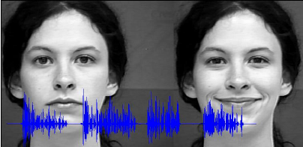
Conclusion
Right now, AI can’t copy the emotions of humans
In the future, it is possible for AI to copy certain forms of expression and possibly emulate human emotion when interacting with human beings

Slide 7
Resources
http://www.scholarpedia.org/article/Speech_emotion_analysis
https://www.frontiersin.org/articles/10.3389/fcomp.2020.00014/full
https://raphaellederman.github.io/articles/audioprocessing/#

